Slide 1
Recipe Sharing API
Raihan Romzi R - diBimbing Backend Developer

Slide 2
Table of contents
1
Sharing Recipe API
2
Requirements
3
Tech Stack
4
Routes
5
Demo
Introduction
Architecture Diagram, ERD
NodeJS, Express, MySQL, FlyIO, Planet Scale
API Endpoint
Live Demo Program

Slide 3
1
Sharing Recipe API
Introduction

Slide 4
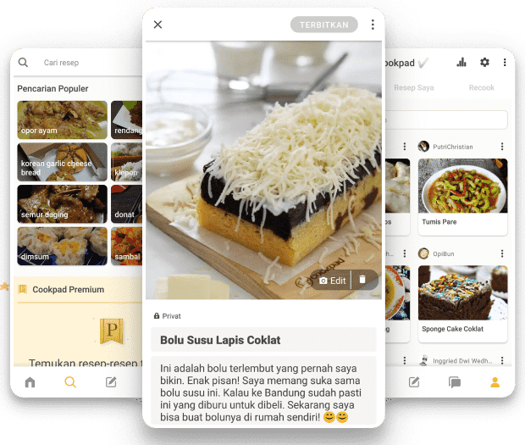
Introduction
API recipe is a type of recipe that can be used to create REST API endpoints. Using the API Platform feature, you can expose these endpoints to external users or utilize them in other recipes. API that provide services to save and share recipes.

Slide 5
2
Requirements
Architecture Diagram, ERD

Slide 6
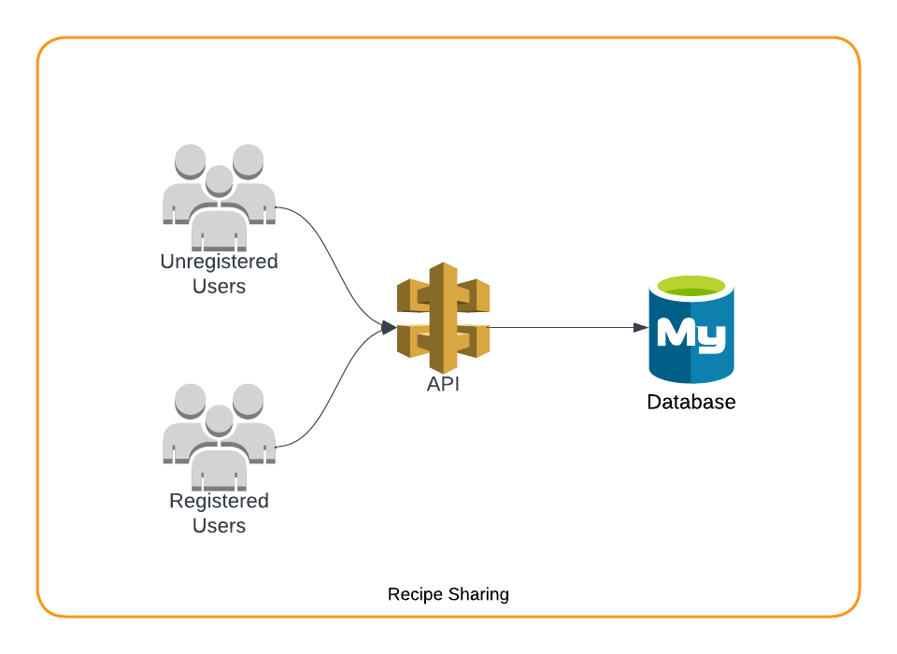
Architecture Diagram

Slide 7
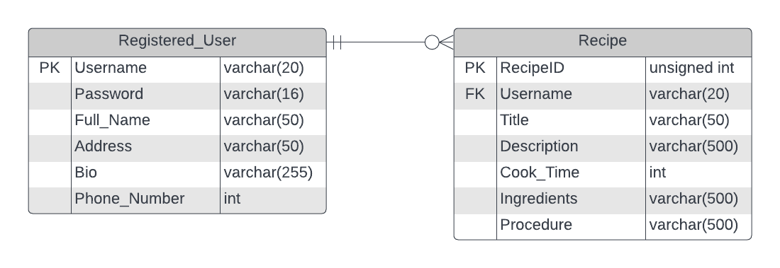
Entity Relationship Diagram

Slide 8
3
Tech Stack
NodeJS, Express, MySQL, FlyIO, Planet Scale

Slide 9





Tech Stack

Slide 10
4
Routes
API Endpoints

Slide 11
API Endpoints
Users
Recipes
GET /api/v1/users
GET /api/v1/users/:username
GET /api/v1/users/:username/recipes
POST /api/v1/users
DELETE /api/v1/users/:username
PUT /api/v1/users/:username
GET /api/v1/recipes
GET /api/v1/users/:username/recipes/:recipeID
POST /api/v1/users/:username/recipes
PUT /api/v1/users/:username/recipes/:recipeID
DELETE /api/v1/users/:username/recipes/:recipeID

Slide 12
5
Demo
Live Demo App

Slide 13
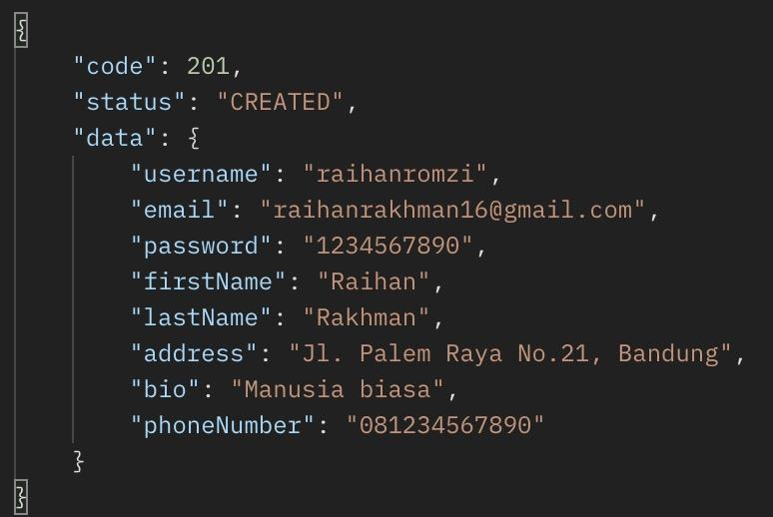
Success Response

Slide 14
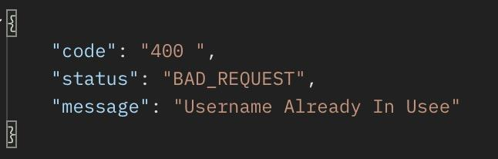
Error Response

Slide 15


https://recipe-sharing.fly.dev
https://github.com/raihanromzi/recipe-sharing-api
Fly.io
Github

Slide 16
Thank
You

